Slide 1
Lecture 4
Pointers to: pointers; arrays and structures.

Slide 2
Pointers to pointers
A pointer can also pointer to another pointer which in turn pointers to a “standard” variable:
int i=3; // an integer variable int *j; // a pointer int **k; // a pointer to a pointer (double pointer)
j=&i; //line 1 (assigned address of an integer)
k=&j; //line 2 (assigned the address of a pointer)

Slide 3
Examples
What is output of the following statements
printf(“%d”, **k);
printf(“%p”, *k); printf(“%d”,*j); printf(“%d”,i);
Assume the following: i = 3, j = &I; k = &j

Slide 4
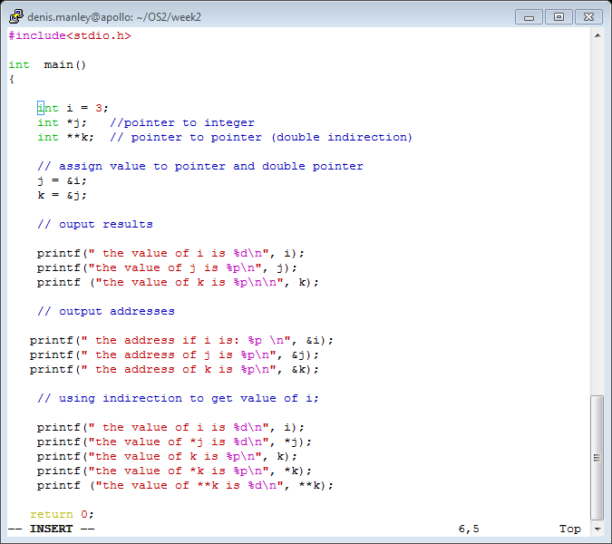
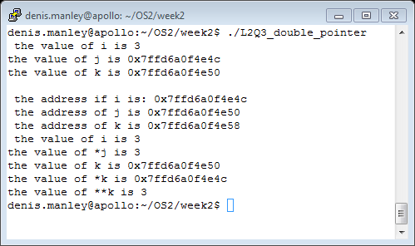
Double_pointer code and output

Slide 5
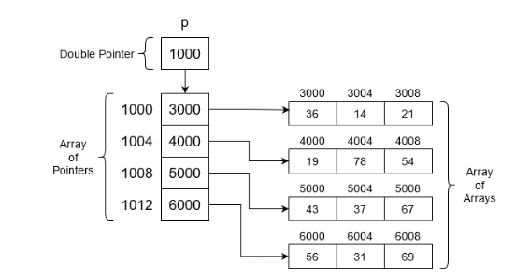
2 D Array
A 2_D array is essentially :
an arrays of pointers (variables that store an address)
Each element of the 2_D array can be accessed using subscripts or pointers / double pointers

Slide 6
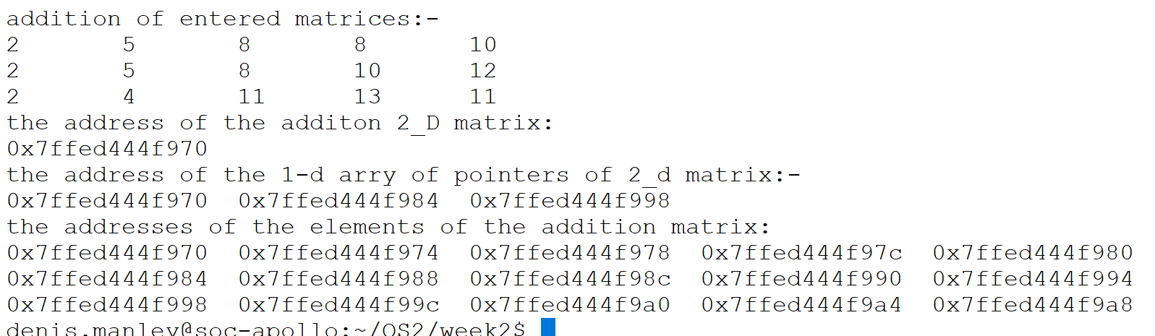
2D Matrix and Address
The array name stores the address of the first element of 1_D array of pointers (double pointer (**) to single pointer(*)
Each element of this 1-D array of “pointers” stores the address of the first element of an array of standard variables: a row of the 2_D a matrix.

Slide 7
Array of pointers
2_D array of integers:
int matrix[3][4]; //declare 2_D array
Access individual elements using subscript notation:
printf(“ value of row 2 col 2 is %d”, matrix[1][1]);
Actual Implementation: Access elements using pointer variables:
printf(“ value of row 2 col 2 is %d”, *(*(matrix + 1) + 1));
access the 1_D array of pointers *(matrix + 1)
Access an element of the of the 2_D array via *(*(matrix + 1) +1)
Explain clearly how the pointer notation prints row 2 col ?

Slide 8
Manipulate 2_D array
To access each element you need to use nested for loops; consider a 3x3 matrix
To print each value
for (row = 0; row<3; row++)
for (col = 0; col <3; col++ )
printf(“%d “, matrix[row][col] ); // can also use pointer arithmetic
Class Question: How would you calculate and display the addition of two matrices.

Slide 9
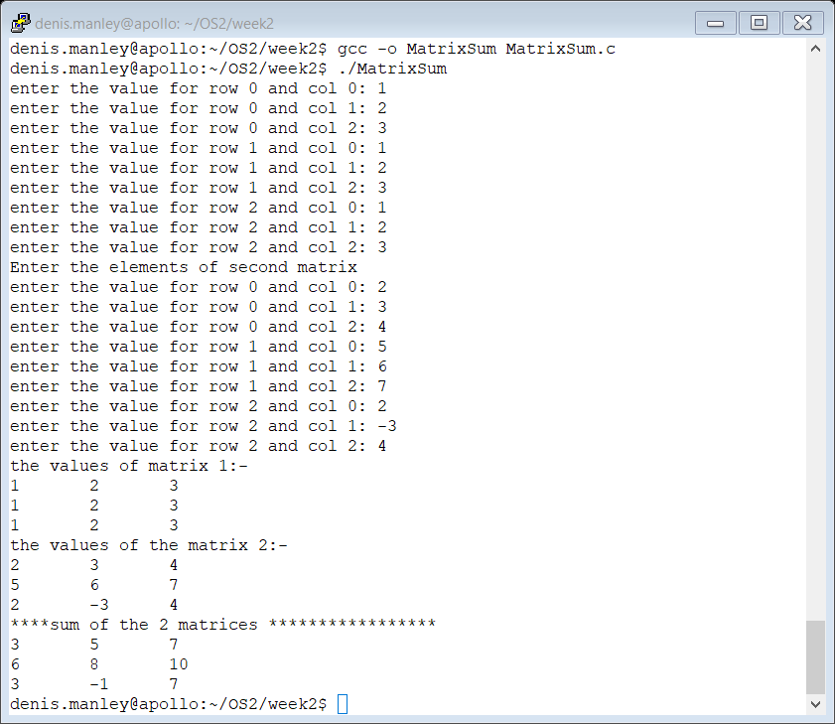
Sample output Matrix Addition: (MatrixSum.c)

Slide 10
Matrix multiplication
How would you perform matrix multiplication of two matrices?
The following link describes how to multiply two matrices: matrix multiplication
Refer to the 3x3 image file on web courses

Slide 11
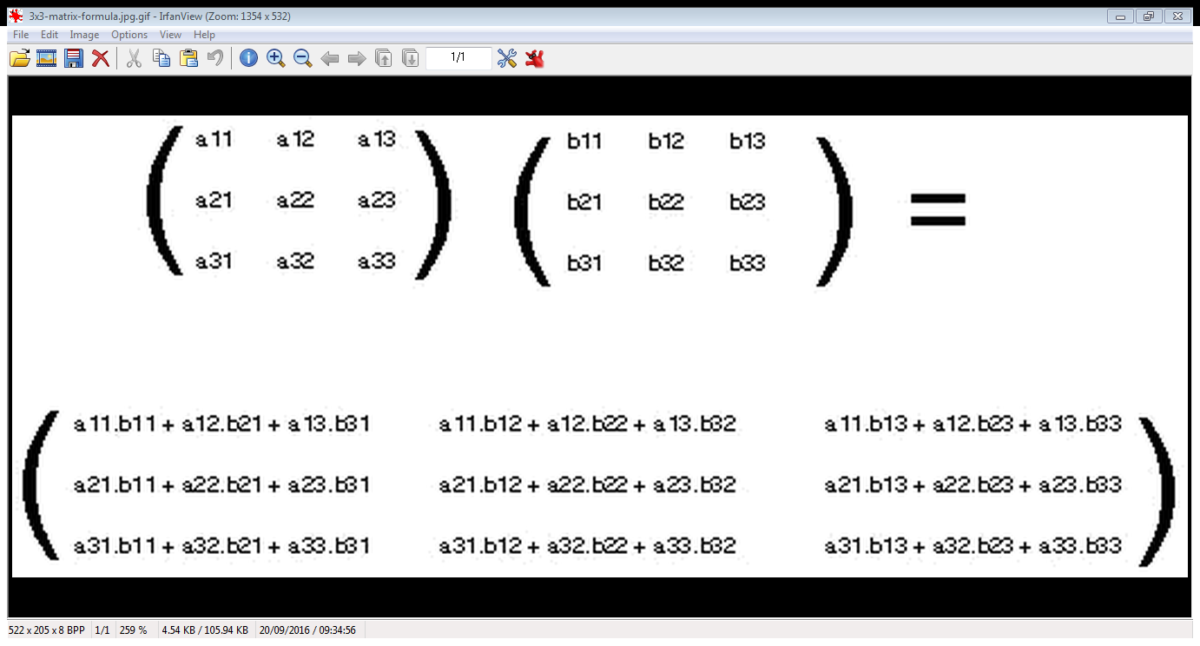

Slide 12
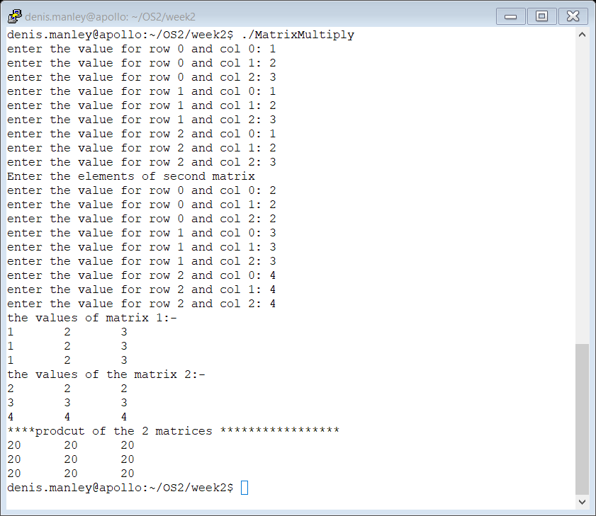
Sample output

Slide 13
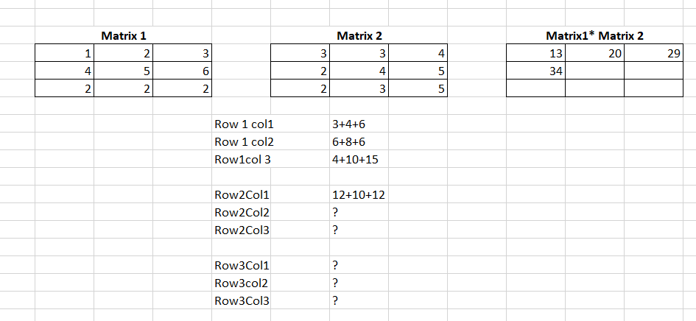
Matrix Multiplication exercise

Slide 14
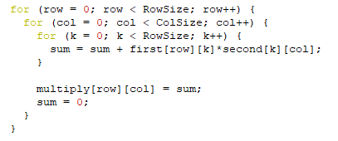
3 For loop: matrix multiplication
Sample C code to multiplying 2_D matrices of the same dimensions :

Slide 15
Array of string pointers
If you wanted to create an array to store all the months [strings] of the year you could
Create a 2_d character array: e.g. char month[12][10]
Why would this be inefficient? (hint: sparsity)
Another option is to create an Array of Characters Pointers: e.g. char *months[12]
Each element is then treated an a char * ( essentially a string)
Remember you must assign memory for each using char *months[0] = “January”
The address of J is assigned to element 0
Consider the following program

Slide 16
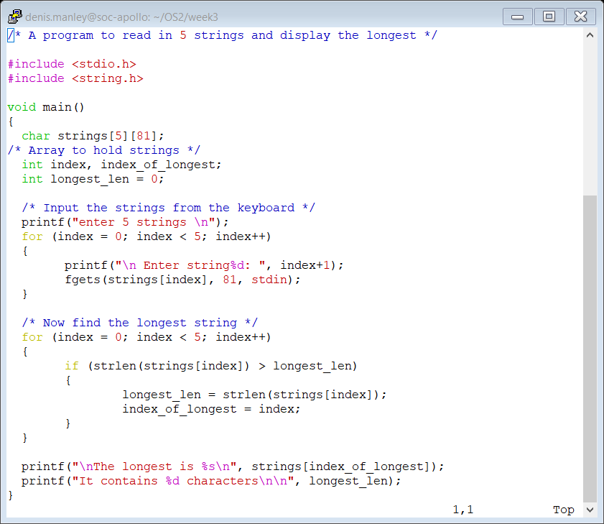
2-D character array (LONGSTR.C)
Input strings (using 2-D character array)

Slide 17
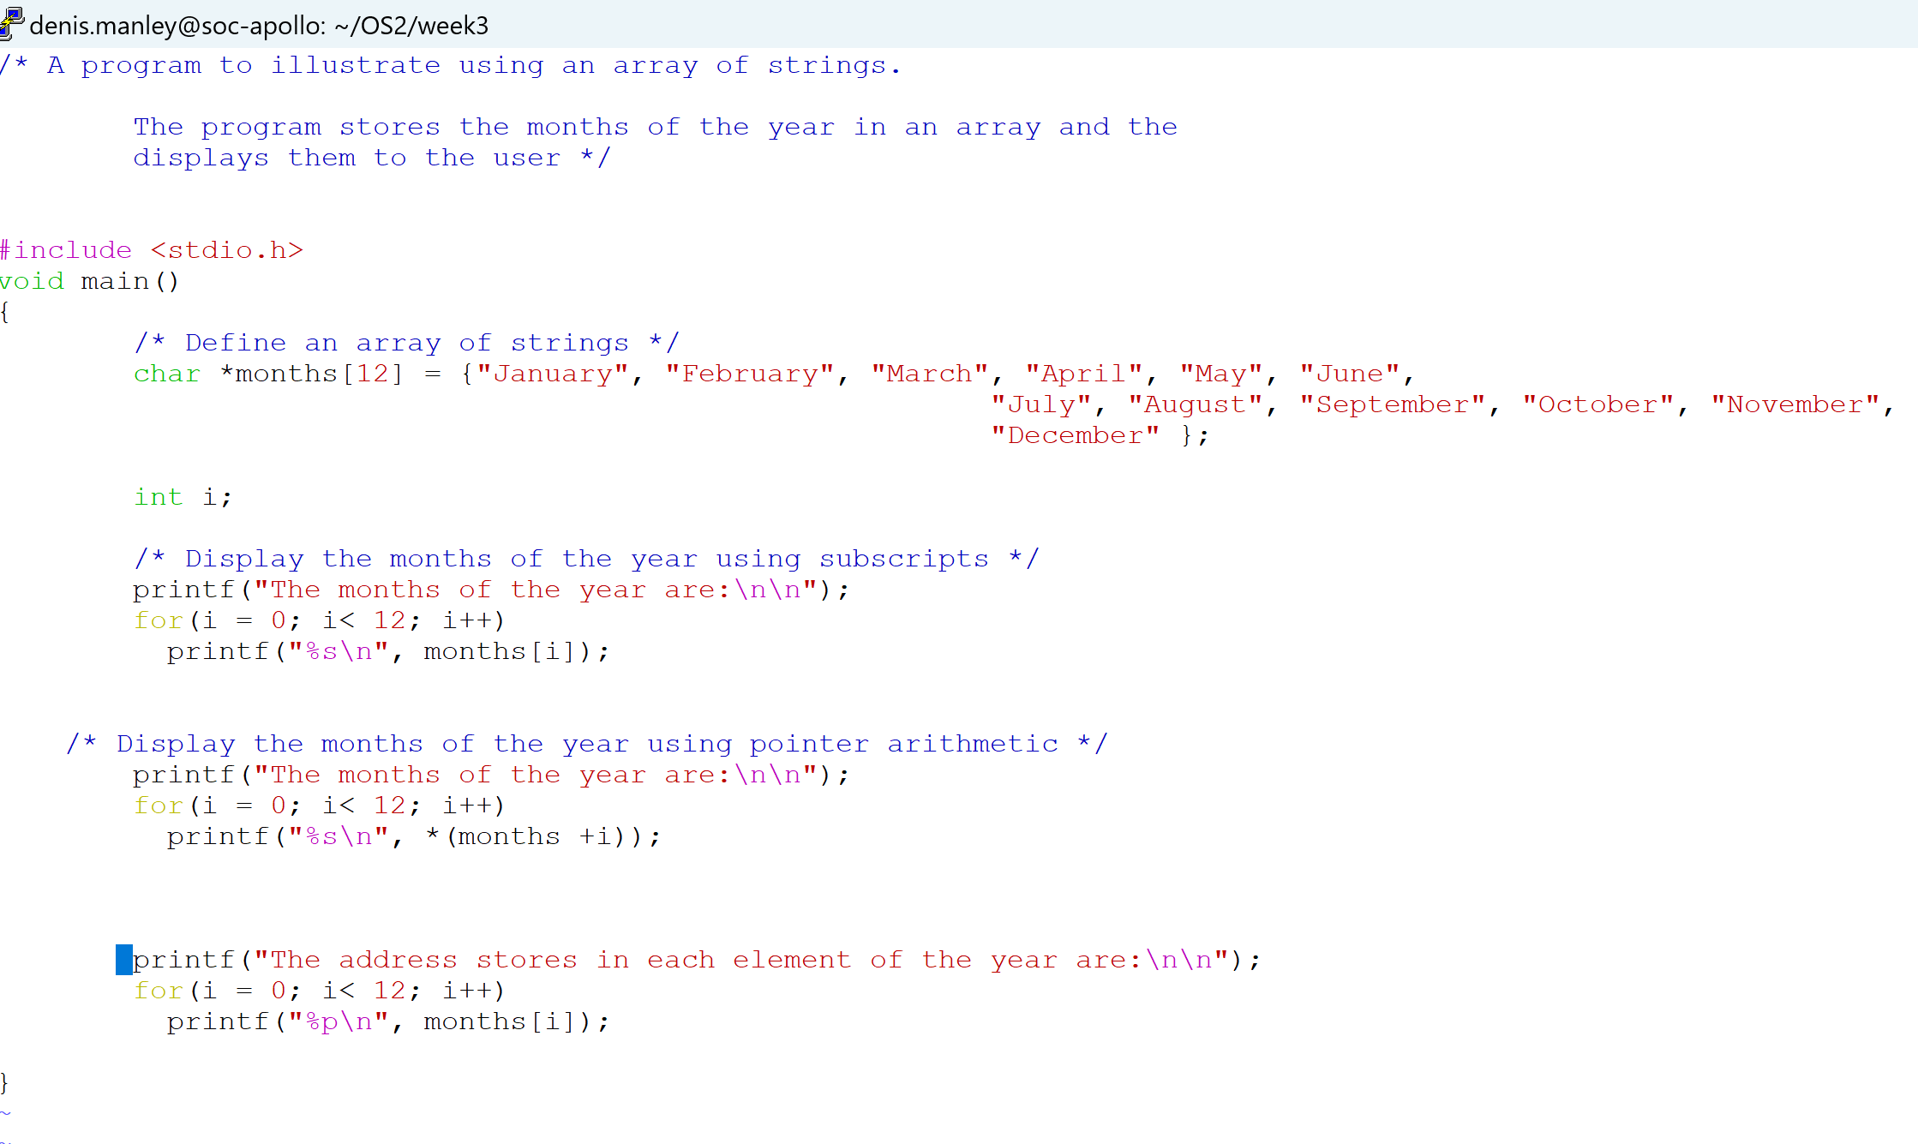
Array of string: months.c

Slide 18
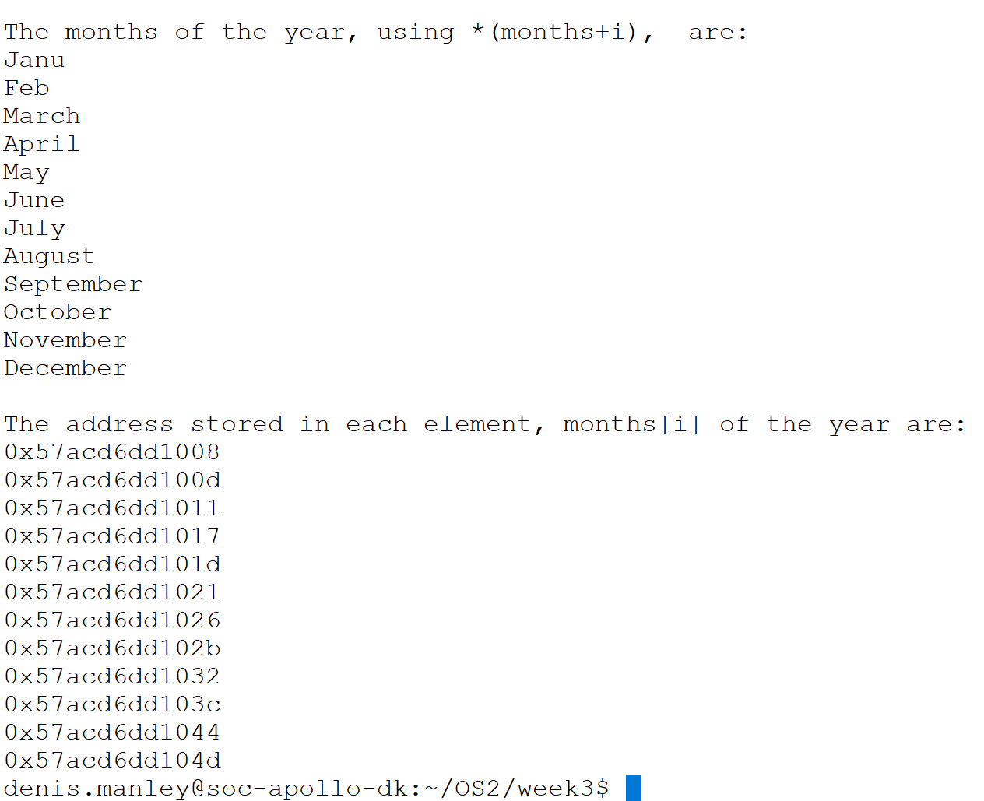
Partial Sample Output of months.c

Slide 19
Home work
Explain using the above code (longstr.c and months.c), and with a suitable example, why a character pointer array is more efficient than a 2_D array of characters in terms of the memory allocated. (Hint: show the memory allocated for the 2_D array and compare with the address shown in the previous slide.

